Slide 1
Maze – Q-learning
2023/05/04

Slide 2
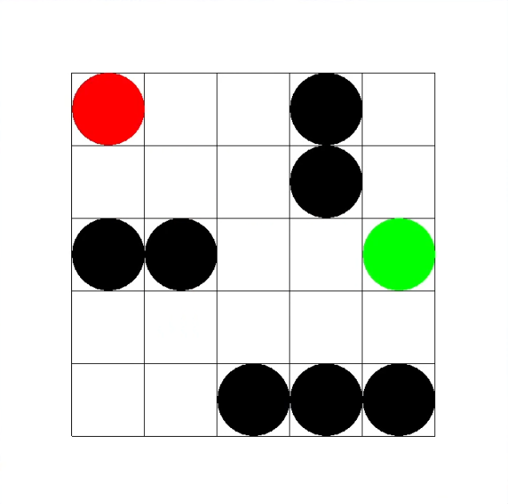
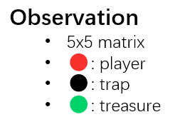
Environment Introduction
Action
0: ↑ move up
1: ↓ move down
2: ← move left
3: → move right
Observation
5x5 matrix
🔴: player
⚫: trap
🟢: treasure
Action Space | Discrete(4)
Observation Space | Discrete(25)
Reward
Trap: -1
Treasure: 1
(Else: -0.01)

Slide 3
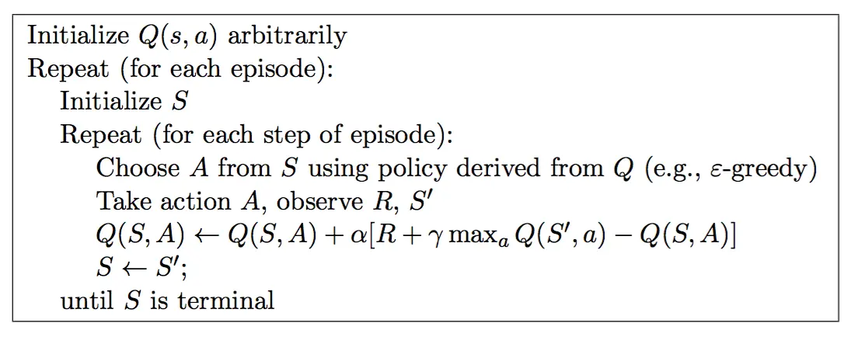
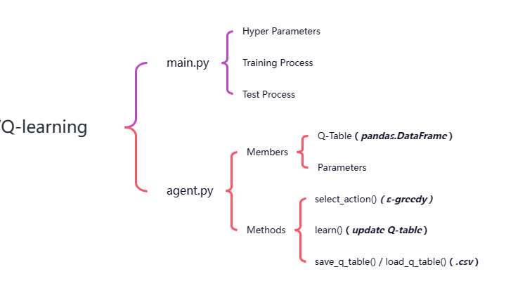
Algorithm
Q-learning

Slide 4
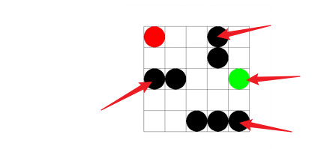
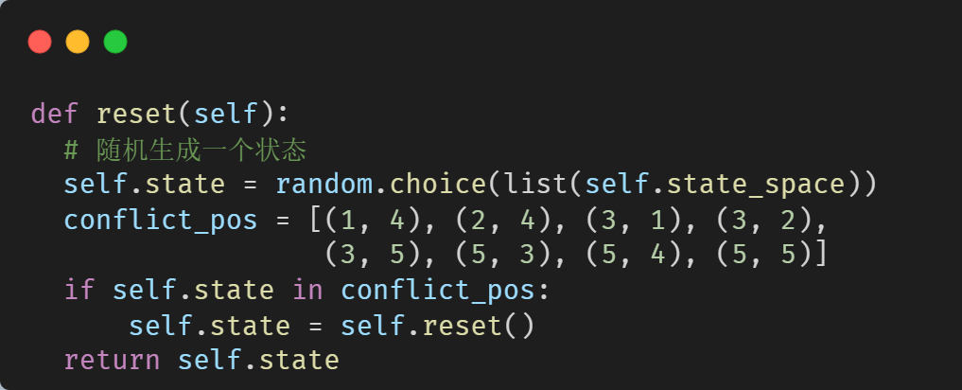
Implementation
Fix

Slide 5
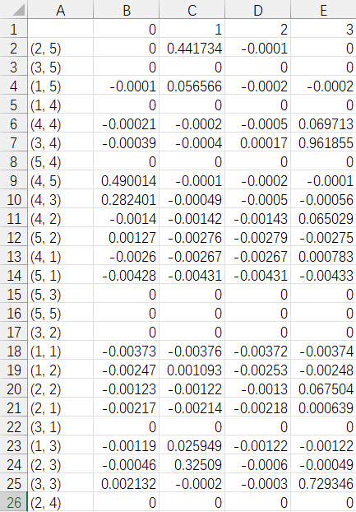
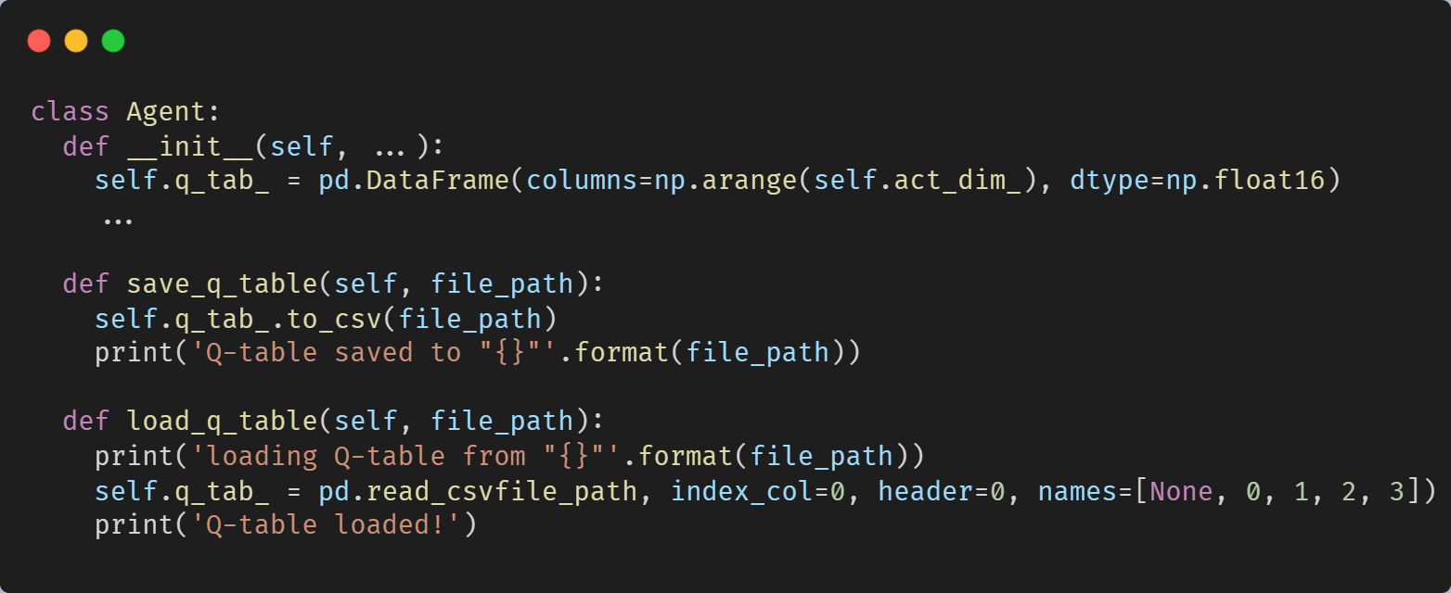
Implementation
Q-Table

Slide 6
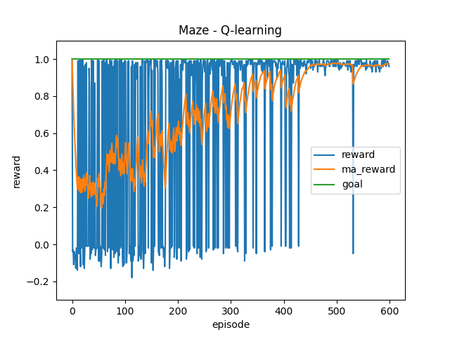
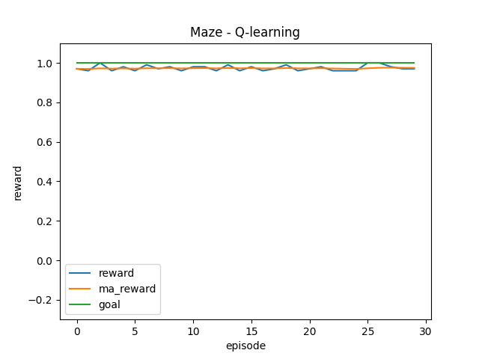
Training (ε=0.9*0.995^n)
Test (ε=0)

Slide 7
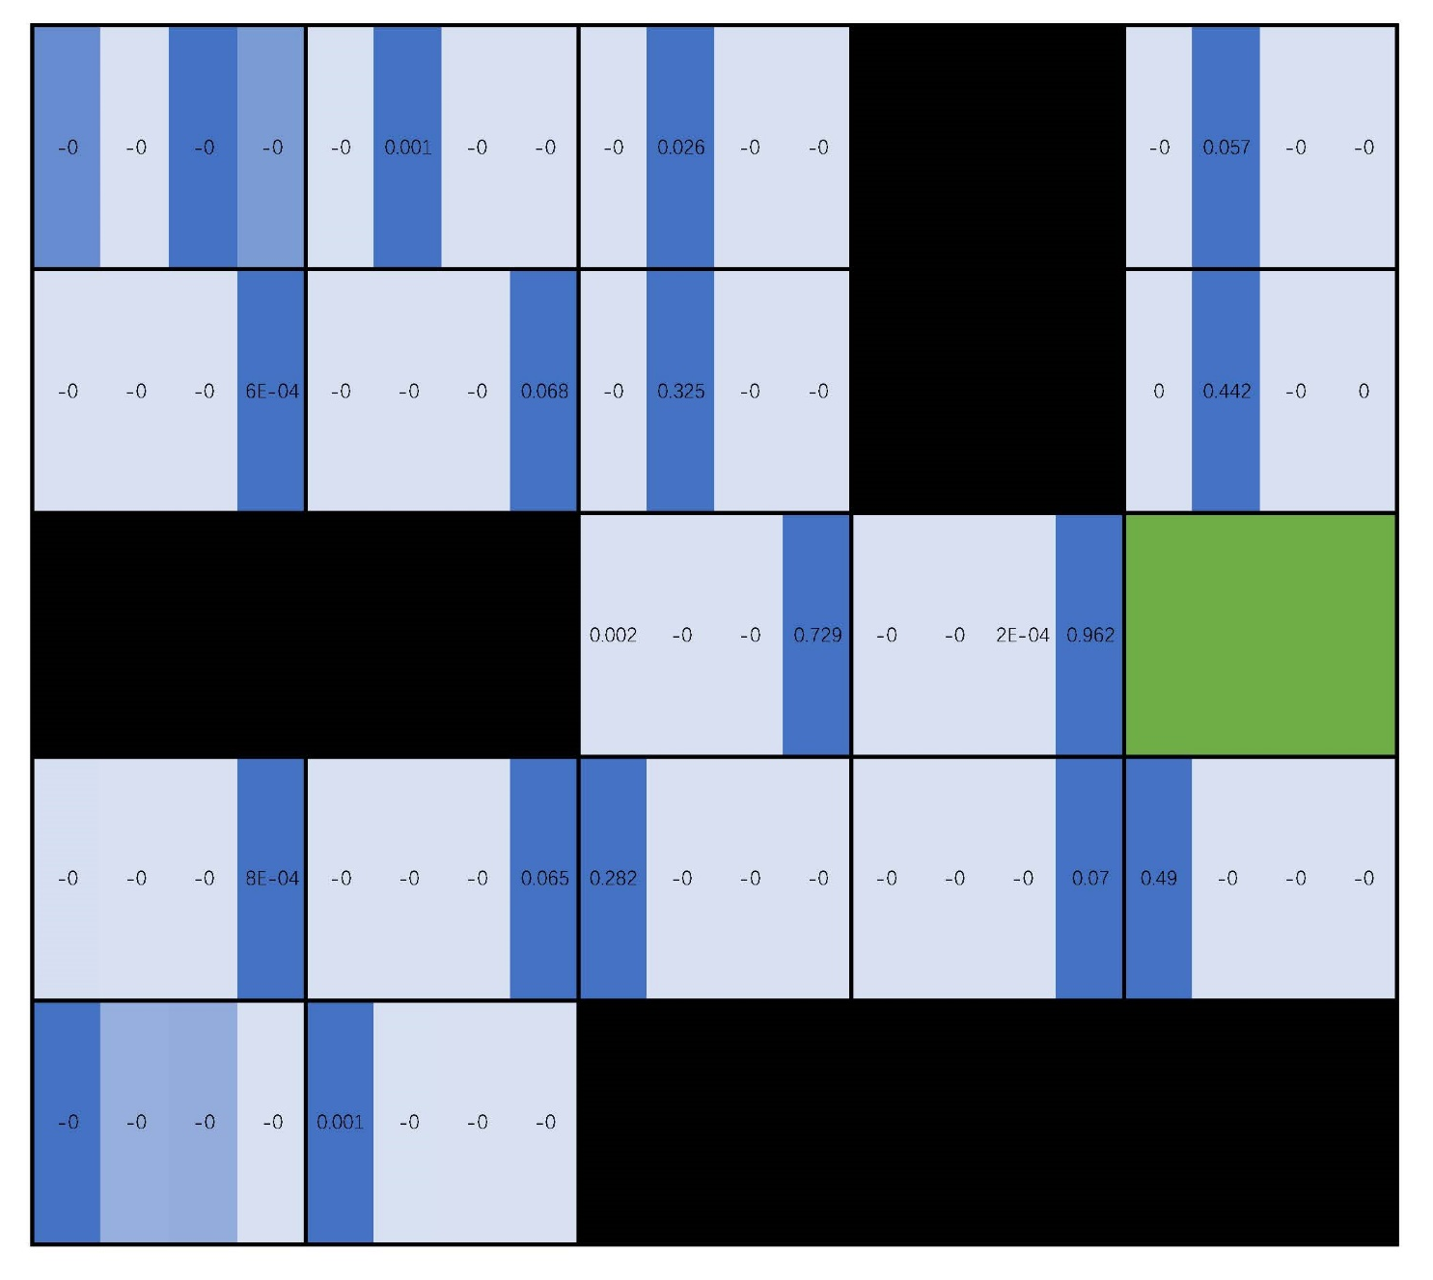
Q-Table
↑ 上 | ↓ 下 | ← 左 | → 右

